Slide 1
Power ADC
Project members:
Peter van Anrooij,
Remco Bonten,
Maarten Hattink,
Frits Smits

Slide 2
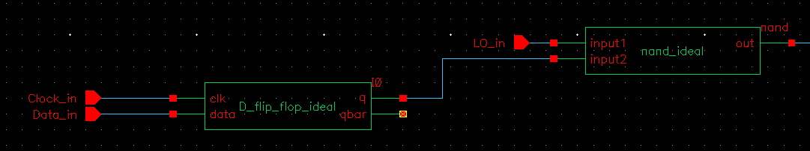
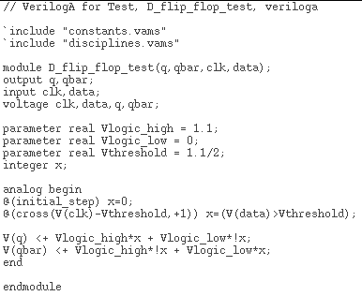
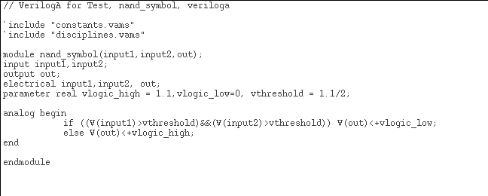
D flip-flop and NAND port Ideal design

Slide 3
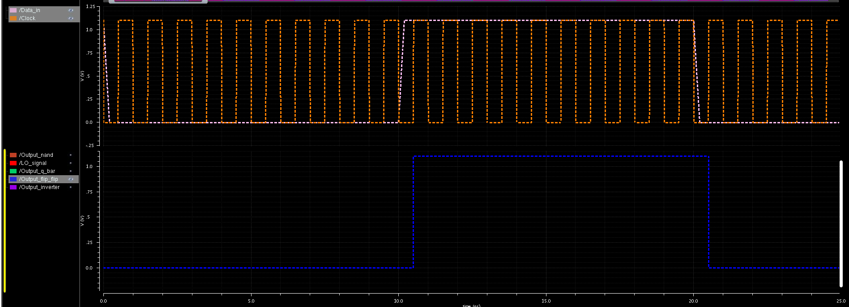
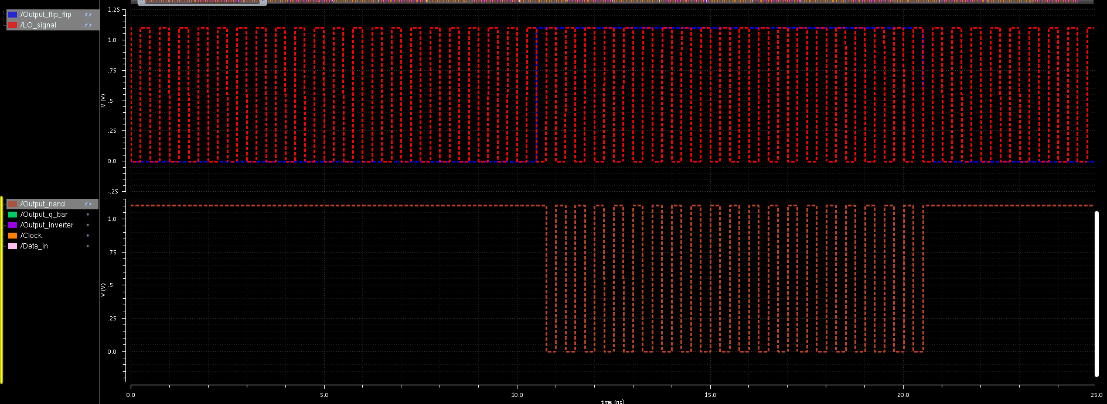
Simulation D flip flop and NAND
Simulation values D Flip flop
Data in: 50 MHz signal
Clock: 1 GHz
Simulation values NAND
LO signal: 2 GHz
Data from the D flip flop

Slide 4
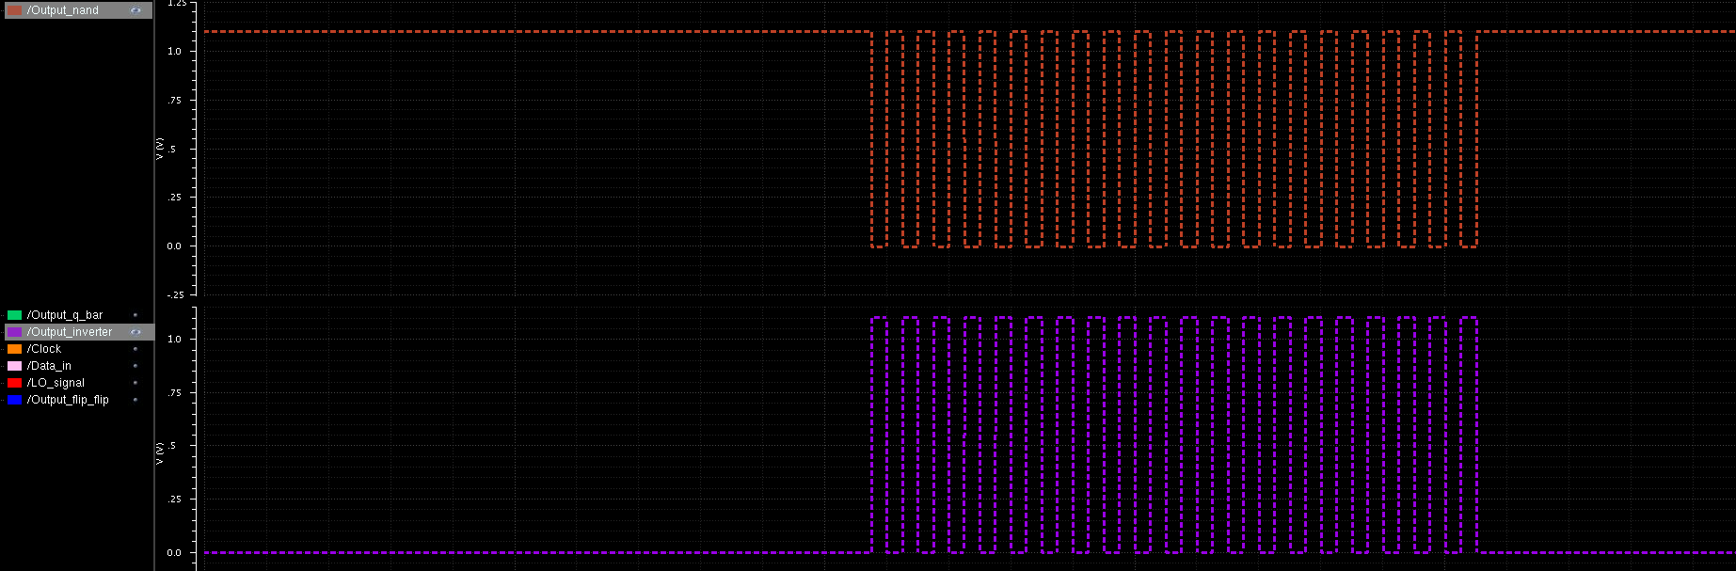
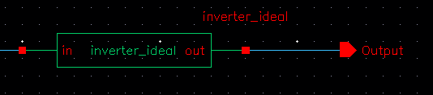
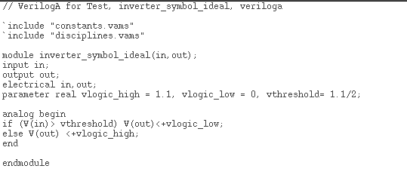
Inverter
Planning:
- 4/12: Read more about the subject and play with cadence
- 9/12: Ideal design D Flip-flip, NAND and inverter
x/12: Designing inverter
x/12: Simulate inverter
x/12: Designing NAND
x/12: Simulate NAND
x/1: Designing D flip flop
x/1: Simulate D flip flop
x/1: Integrate the blocks

Slide 5
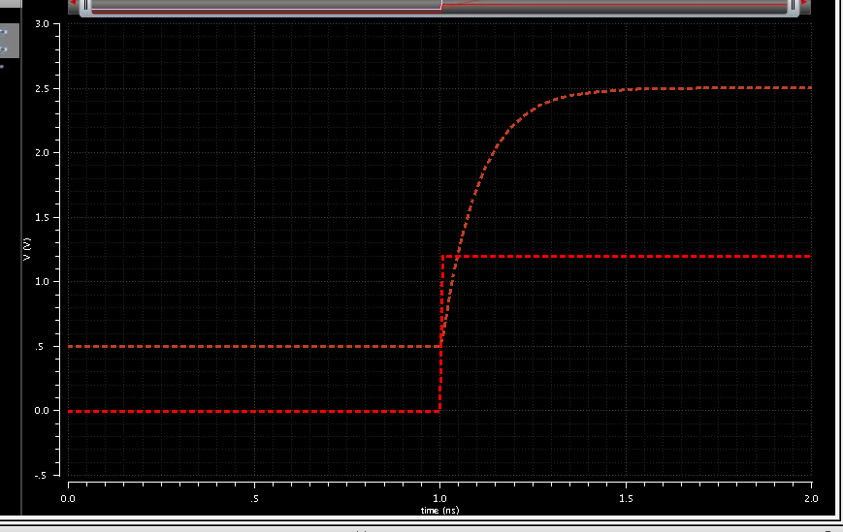
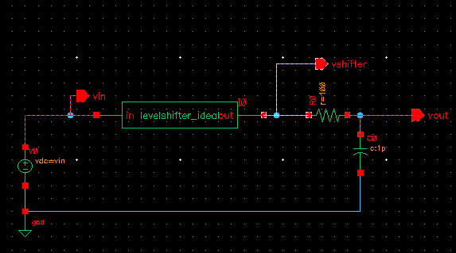
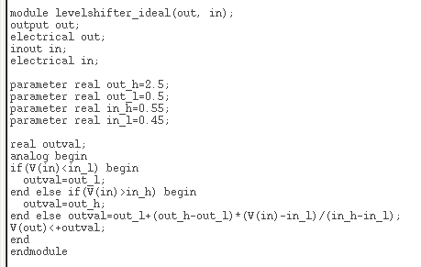
Level shifter
Planning:
21/11: Initial design of level shifter
17/11: Fully simulated design of level shifter

